Slide 1


KIET GROUP OF INSTITUTIONS
MCA 2023-25
MYMATE
(SDG: Quality Education)

Slide 2

GROUP MEMBERS
Mentor
Mr. Shish Pal
Assistant Professor
Abhinav Kajla
1
3
Ashutosh
(Database management)
(Backend development)
Divyanshi Bhadauria
2
4
Divyansh Chauhan
(Frontend development)
(Team lead, Frontend development)

Slide 3


EXIGENCIES
Professional Interaction
Guidance
Mentoring
Resource availability
Collaboration

Slide 4





CONCEPTION
HUMAN INTERACTION
To make peoples interaction comfortable
Break down the communication barriers
RESOURCE
Providing study material
Providing the roadmap
ADVANCEMENT
Keep track of activities
Progress

Slide 5





IMPLEMENTAION PLAN
UI/UX Design
Coding Phase
Database Design
User Authentication
Testing
Deployement

Slide 6









ASSETS REQUIRED

Slide 7
Litrature Review
Social Networking Sites
Features and Functionalities of Professional Networks
User Engagement and Content
Technical Architecture and Implementation
User Privacy and Ethics

Slide 8
MODULES
Login and Signup
Home page
Profile
Chatting
Network
Post

Slide 9
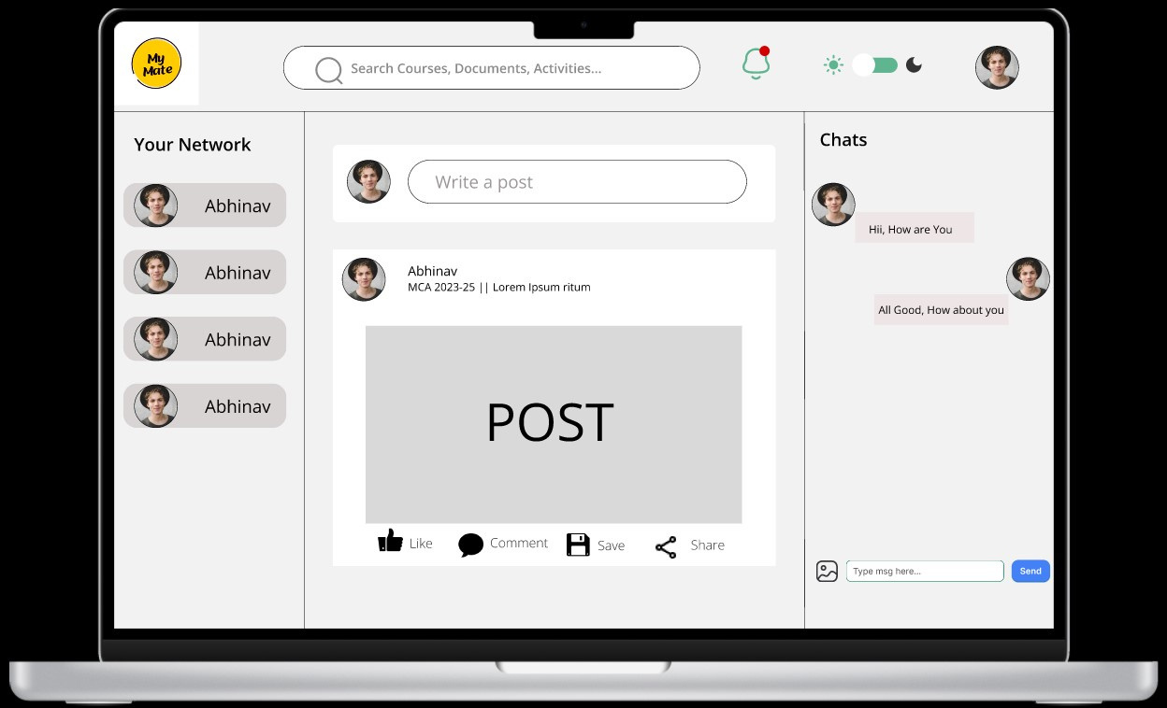

PRODUCT

Slide 10
Github MERN Boilerplate: https://github.com/Hashnode/mern-starter
freeCodeCamp (2020). How to Build a MERN Stack Application. Blog and Tutorial.
Mongoose: https://mongoosejs.com/ https://www.freecodecamp.org/news/build-a-mern-stack-application/
Node.js Documentation: https://nodejs.org/en/docs/
React.js Documentation: https://reactjs.org/docs/getting-started.html
Express.js Documentation: https://expressjs.com/en/guide/routing.html
Grider, S. (2019). Node with React: Fullstack Web Development. Udemy.
This course provides a comprehensive guide to building full-stack applications using Node.js and React, focusing on how these two technologies integrate and work together within the MERN stack.
Rangel, F. (2019). Mastering Full-Stack React Web Development. Packt Publishing.
This book is an in-depth guide to using the MERN stack. It covers building APIs with Node.js and Express, as well as integrating MongoDB with React for front-end development.
REFERENCES

Slide 11
THANK YOU

